Slide 1
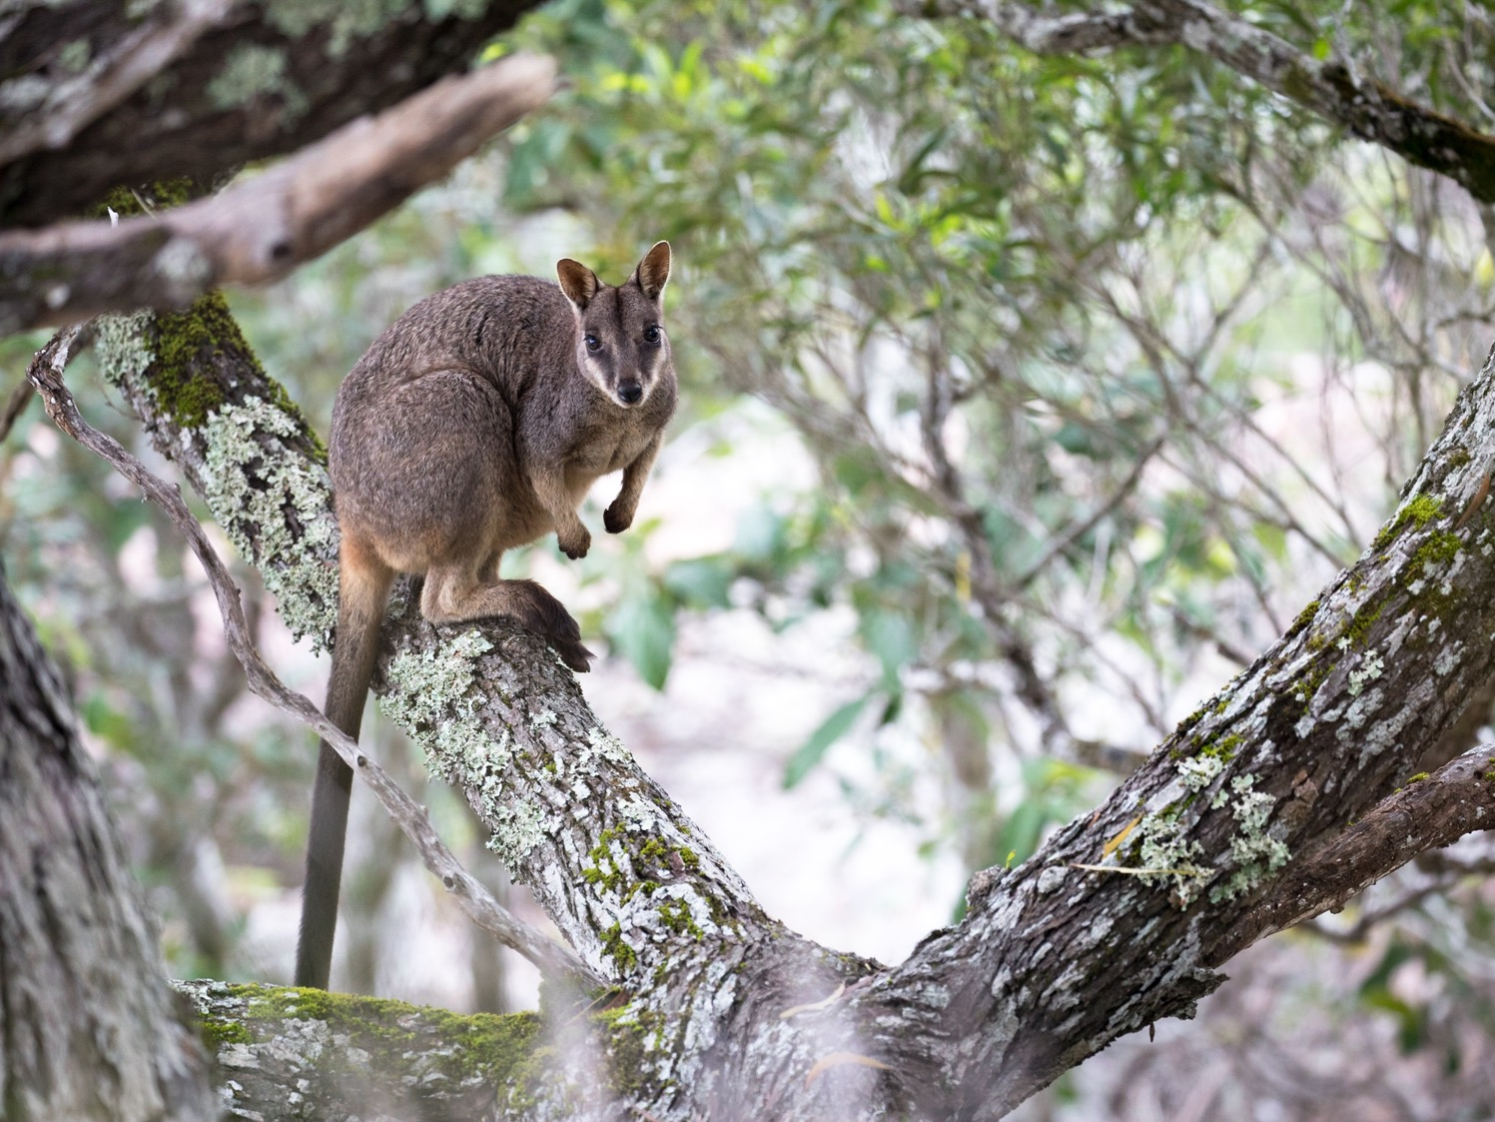
BIOL365: Marine and Terrestrial Ecology
Practical 3: Genetic alignments and phylogenies
James Dorey, Damien Esquerré, and Phil Byrne

Slide 2
Assignment 1
Part a — 10%
Part b — 10%

Slide 3
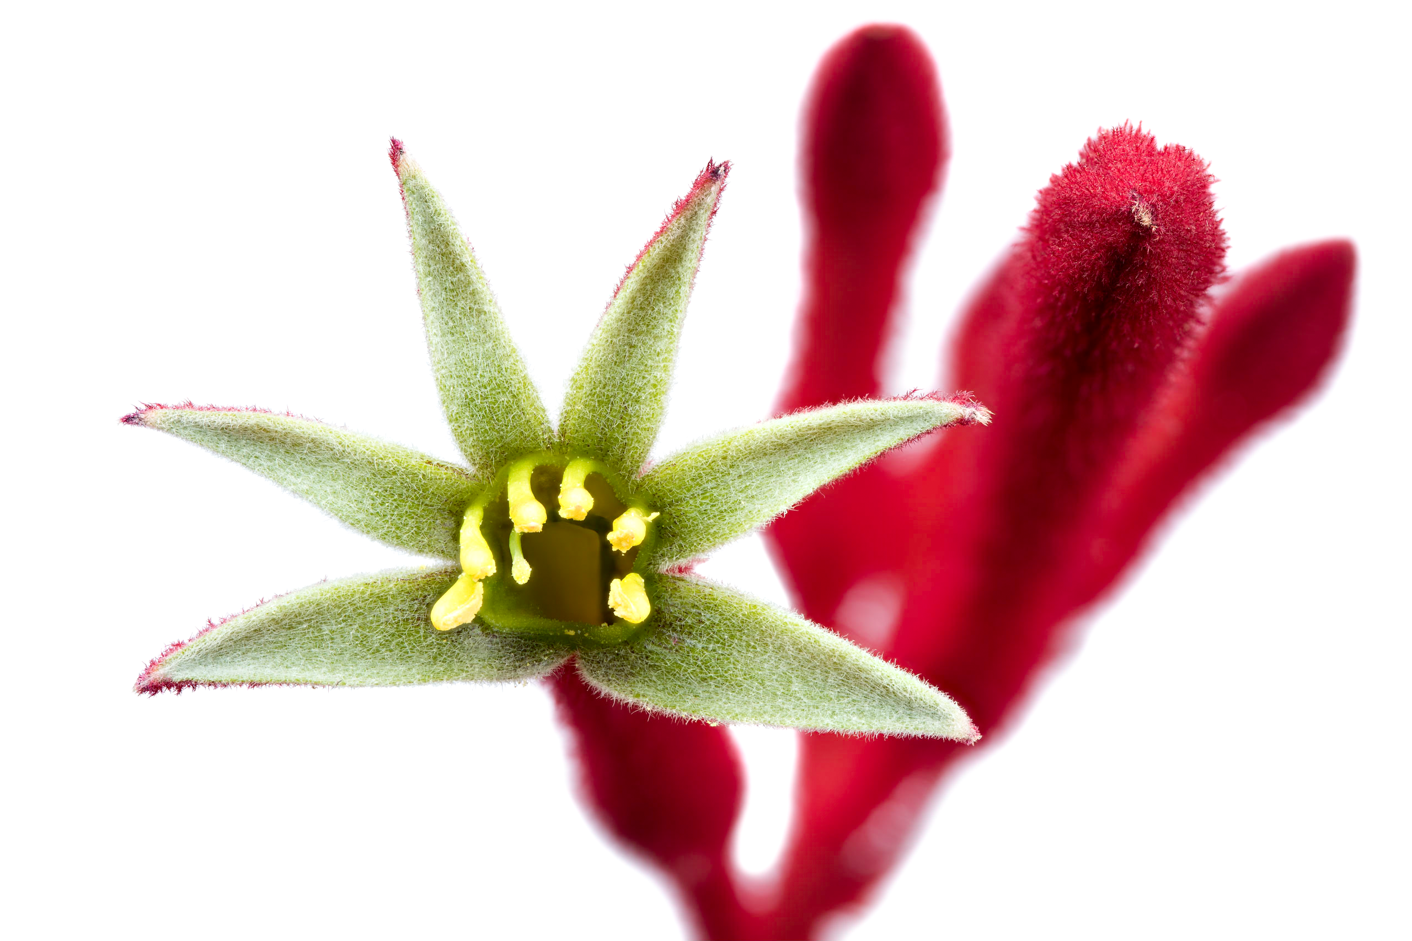
What to expect today
Script preparation
Prepare GenBank data
Filter sequences
Align sequences
Make a phylogeny

Slide 4
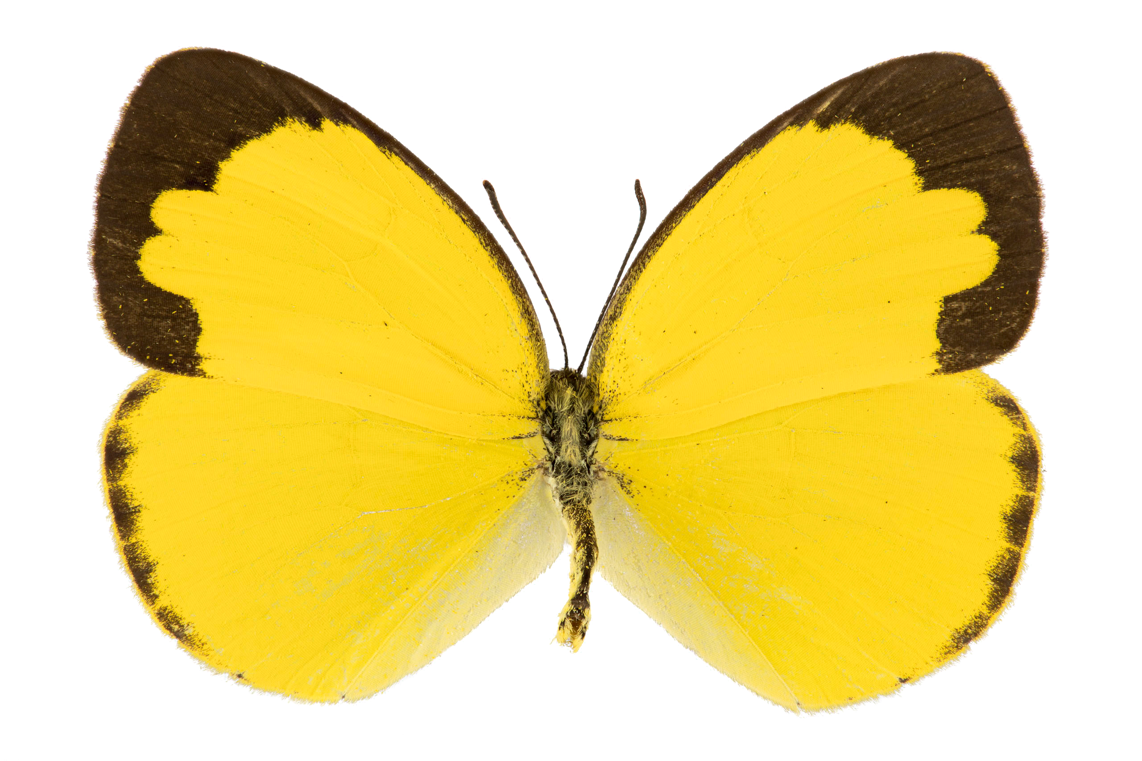
Script preparation
Usually, you will do this every time you open a project
Consider good practice and what’s easiest in the long run
Questions about HOW you set your working directory

Slide 5
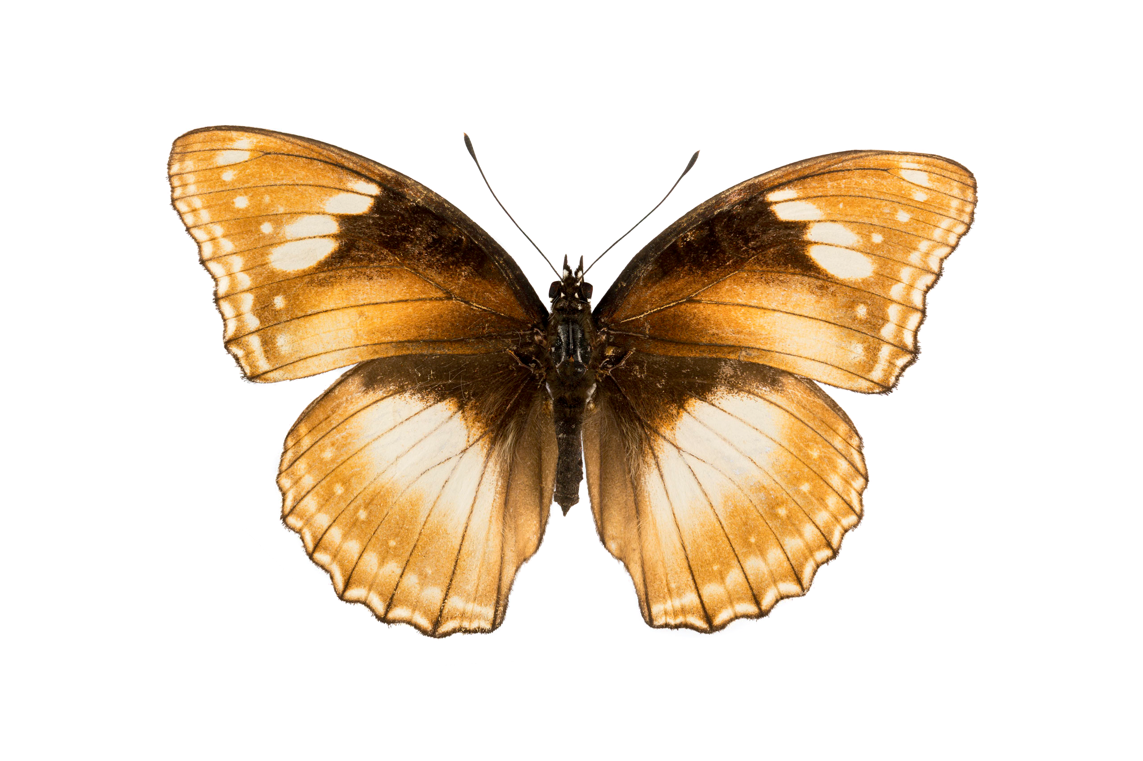
Prepare GenBank data
You will use my finch data version from Website or Moodle
We will also download an OUTGROUP species
This helps us “root” our phylogenetic tree and better-determine the relationships within our clade of interest

Slide 6
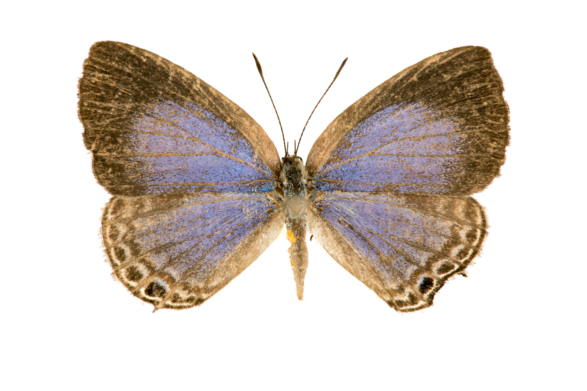
Filter sequences
Filter sequences to simplify our analyses (one individual per species)
There will be data management along the way
You can almost read tidyverse code like a flowing sentence
Much of this code is useful, but you should remember WHAT you can do and decide if you want to use if for your assignment

Slide 7
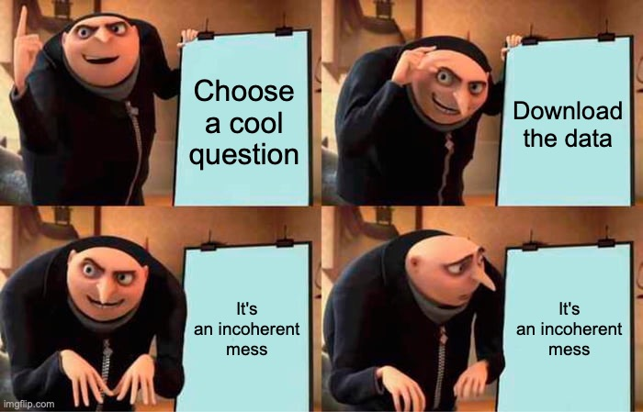
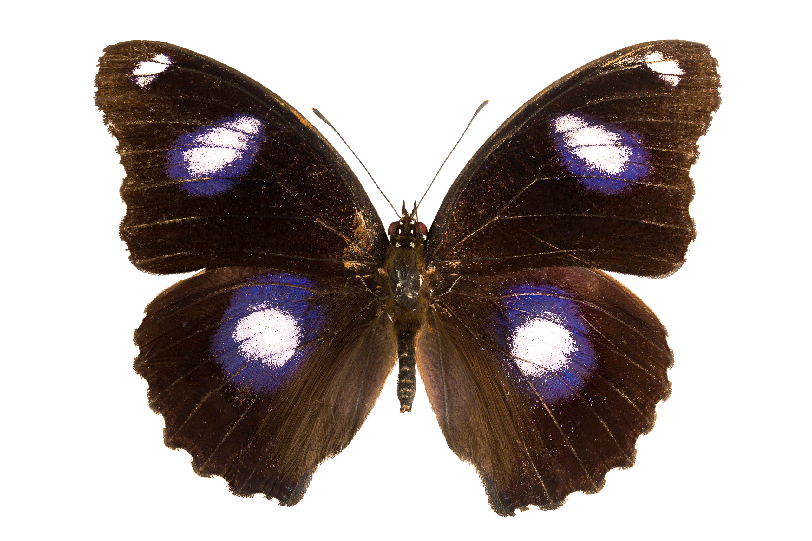
Align sequences
Sequences don’t come aligned so that they are identical by descent (homologous)
Most geneticists have fancy programs for this… we’ll be simple (and cheap)

Slide 8
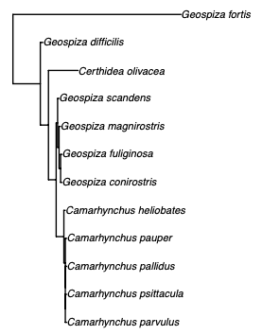
Make a phylogeny
Use genetic data to examine the patterns of relatedness between individuals
We will use two methods today:
Distance tree (very simple)
Maximum likelihood (much more complex)
Model testing (for models of evolution)
Rooting the tree

Slide 9
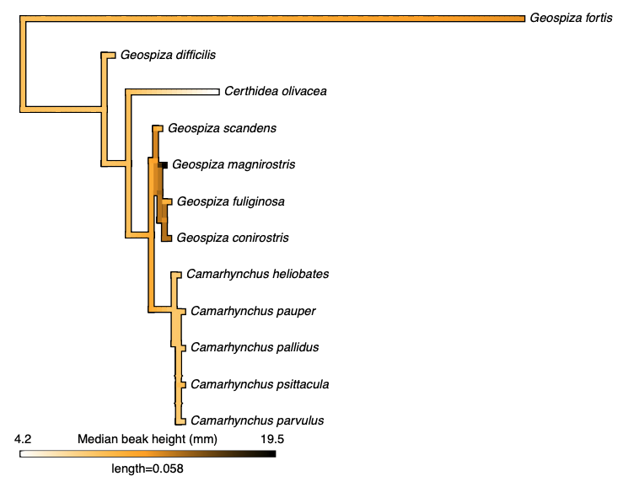
Make a phylogeny
This week:
Next week:

Slide 10
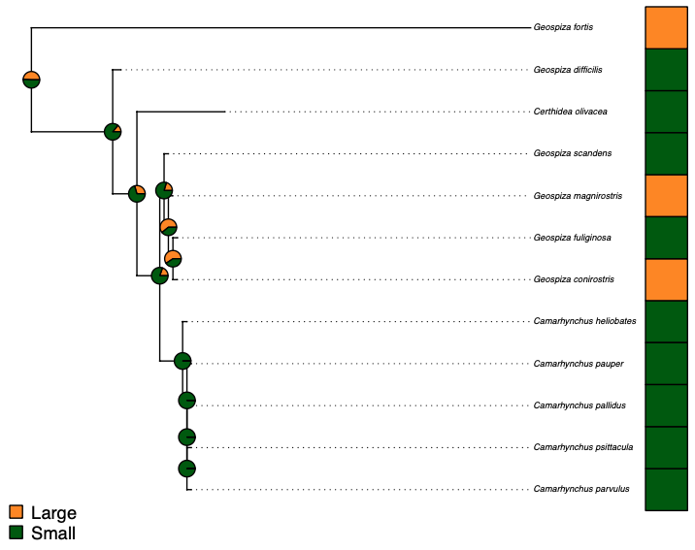
Make a phylogeny
This week:
Next week:

Slide 11
Did you finish early?
Help your neighbour
Get your answers checked
Work on your assignment and seek help or advice (keeping in mind that others doing the prac might need more help)
???
Okay, fine you can go

